Slide 1

A Project Presentation on
SimpleSaral : " Smart Document Navigator "
Under The Guidance of
Mrs. Poonam Chavan
Presented by :
Second Year,Department of Computer engineering
Harshad Dhonde
Rhoit Dhaygude
Mahesh Dasarwad
Aditya Chapale
DYPCOE Akurdi,Pune Project Presentation
1

Slide 2
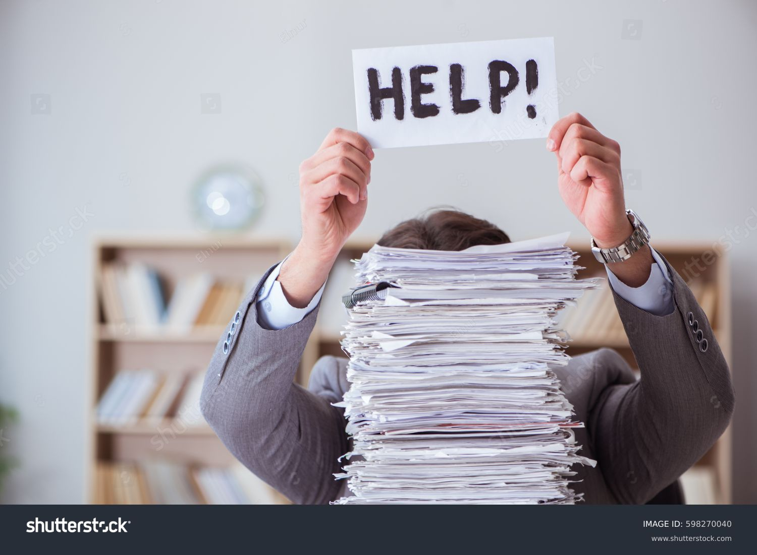
1.Problem Statement
Many citizens struggle to identify and gather the correct documents needed for various government schemes and organizational programs.
This leads to :-
Multiple visits to offices
Rejected applications
Wasted time and resources
Increased frustration with bureaucratic processes
Missed opportunities due to incomplete documentation
Project Presentation
2

Slide 3
2. Objectives
Create a user-friendly web platform that provides accurate documentation requirements
Implement a smart search system to find relevant schemes
Generate customized document checklists for users
Provide downloadable document templates where applicable
Project Presentation
3

Slide 4
3. Methodology
Research Phase
Gather documentation requirements for various schemes
Study existing systems and their limitations
Conduct user surveys to understand pain points
Design Phase
Create user interface wireframes
Design database schema
Plan system architecture
Development Phase
Implement frontend and backend systems
Create database of schemes and documents
Develop search algorithms
Build user authentication system
Testing Phase
Conduct user acceptance testing
Perform security testing
Test system performance and scalability
Project Presentation
4

Slide 5
4. Software Hardware Requirements
Software Requirements:
Frontend : HTML5, CSS3, JavaScript, React.js
Backend : Node.js, Express.js
Database : MongoDB
Server : Apache/Nginx
Version Control : Git
IDE : Visual Studio Code
Design Tools : Figma/Adobe XD
Hardware Requirements:
Development System: Processor : Intel i5 or higher
RAM : 8GB minimum
Storage : 256GB SSD
Internet Connection : Broadband
Server Requirements :
Cloud hosting (AWS/Azure/GCP)
Minimum 4GB RAM
50GB Storage
SSL Certificate
Project Presentation
5

Slide 6
5. Conclusion
Bridges citizen-government gap
Improves scheme accessibility
Contributes to digital governance
Scalable solution
Future Scope:
AI integration
Mobile apps
Regional languages
Real-time updates
Project Presentation
6

Slide 7
6. References
Government scheme documentation portals
E-governance research papers
User experience design guidelines
Web accessibility standards (WCAG)
Similar existing platforms in other countries
Technical documentation for chosen technologies
Government APIs and integration guidelines
Data protection and privacy regulations
Project Presentation
7

Slide 8
Question and Answer
Project Presentation
8

Slide 9
Thank you !!!
Project Presentation
9

